Slide 1
Public Goods and Common Resources
CHAPTER 11
Notes:
N. Gregory Mankiw Principles Of Economics Eight Edition

Slide 2
The Different Kinds of Goods, Part 1
Excludability
Property of a good whereby a person can be prevented from using it
Rivalry in consumption
Property of a good whereby one person’s use diminishes other people’s use

Slide 3
The Different Kinds of Goods, Part 2
Private goods
Excludable & Rival in consumption
Public goods
Not excludable & Not rival in consumption
Common resources
Rival in consumption & Not excludable
Club goods
Excludable & Not rival in consumption
One type of natural monopoly

Slide 4
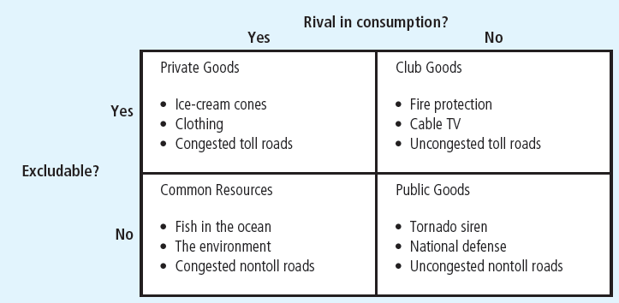
Figure 1 Four Types of Goods
Goods can be grouped into four categories according to two characteristics:
A good is excludable if people can be prevented from using it.
A good is rival in consumption if one person’s use of the good diminishes other people’s use of it.
This diagram gives examples of goods in each category.

Slide 5
The Different Kinds of Goods, Part 3
Public goods and common resources
Not excludable
People cannot be prevented from using them
Available to everyone free of charge
No price attached to it
External effects
Positive externalities (public goods)
Negative externalities (common resources)

Slide 6
The Different Kinds of Goods, Part 4
Public goods and common resources
Private decisions about consumption and production
Can lead to an inefficient allocation of resources
Government intervention
Can potentially raise economic well-being

Slide 7
Public Goods, Part 1
Free rider
Person who receives the benefit of a good but avoids paying for it
The free-rider problem
Public goods are not excludable
Prevents the private market from supplying the goods
Market failure

Slide 8
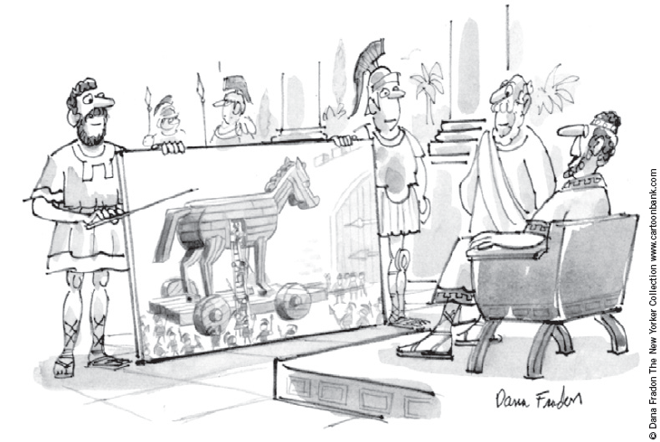
Public Goods, Part 2
Government can remedy the free-rider problem
If total benefits of a public good exceeds its costs
Provide the public good
Pay for it with tax revenue
Make everyone better off
“I like the concept if we can do it with no new taxes.”

Slide 9
Public Goods, Part 3
Some important public goods
National defense
Very expensive public good
$748 billion in 2014
Basic research
General knowledge
Subsidized by government
The public sector fails to pay for the right amount and the right kinds

Slide 10
Public Goods, Part 4
Some important public goods
Antipoverty programs financed by taxes
Welfare system (Temporary Assistance for Needy Families program, TANF)
Provides a small income for some poor families
Food stamps (Supplemental Nutrition Assistance Program, SNAP)
Subsidize the purchase of food for those with low incomes
Government housing programs
Make shelter more affordable

Slide 11
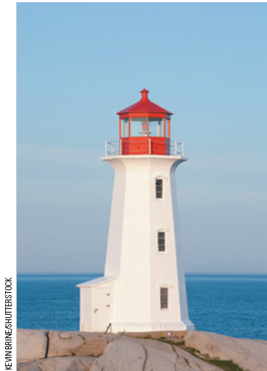
Are lighthouses public goods?, Part 1
Lighthouses
Mark specific locations so that passing ships can avoid treacherous waters
Benefit: to the ship captain
Not excludable, not rival in consumption
Incentive: free ride without paying
Most are operated by the government
What kind of good is this?

Slide 12
Are lighthouses public goods?, Part 2
In some cases
Lighthouses are closer to private goods
Coast of England, 19th century
Lighthouses were privately owned and operated
The owner of the lighthouse charged the owner of the nearby port
If the port owner did not pay, lighthouse owner turned the light off: ships avoided that port

Slide 13
Are lighthouses public goods?, Part 3
Decide whether something is a public good
Determine who the beneficiaries are
Determine whether the beneficiaries can be excluded from using the good
A free-rider problem
When the number of beneficiaries is large
Exclusion of any one of them is impossible

Slide 14
Public Goods, Part 5
The difficult job of cost–benefit analysis
Government
Decide what public goods to provide
In what quantities
Cost–benefit analysis
Compare the costs and benefits to society of providing a public good
Doesn’t have any price signals to observe
Government findings: rough approximations at best

Slide 15
How much is a life worth?, Part 1
Cost: $10,000 for a new traffic light
Benefit: increased safety
Risk of a fatal traffic accident
Drops from 1.6 to 1.1%
Obstacle
Measure costs and benefits in the same units
Put a dollar value on a human life?
Priceless = infinite dollar value

Slide 16
How much is a life worth?, Part 2
Implicit dollar value of a human life
Courts: award damages in wrongful-death suits
Total amount of money a person would have earned if he or she had lived
Ignores other opportunity costs of losing one’s life
Risks that people are voluntarily willing to take and how much they must be paid for taking them
Value of human life = $10 million

Slide 17
How much is a life worth?, Part 3
Cost–benefit analysis
Traffic light
Reduces risk of fatality by 0.5 percentage points
Expected benefit = 0.005 × $10 million = $50,000
Cost ($10,000) < Benefit ($50,000)
Approve the traffic light

Slide 18
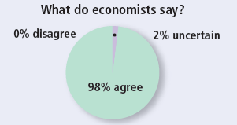
ASK THE EXPERTS
Congestion Pricing
“In general, using more congestion charges in crowded transportation networks — such as higher tolls during peak travel times in cities, and peak fees for airplane takeoff and landing slots — and using the proceeds to lower other taxes would make citizens on average better off.”

Slide 19
Common Resources, Part 1
Common resources
Not excludable
Rival in consumption
The tragedy of the commons
Parable that shows why common resources are used more than desirable
From society’s standpoint
Social and private incentives differ
Arises because of a negative externality

Slide 20
Common Resources, Part 2
The tragedy of the commons
Negative externality
One person uses a common resource diminishes other people’s enjoyment of it
Common resources tend to be used excessively
Government can solve the problem
Regulation or taxes to reduce consumption of the common resource
Turn the common resource into a private good

Slide 21
Common Resources, Part 3
Some important common resources
Clean air and water
Negative externality: pollution
Regulations or corrective taxes
Congested roads
Negative externality: congestion
Corrective tax: charge drivers a tool
Tax on gasoline

Slide 22
Common Resources, Part 4
Some important common resources
Fish, whales, and other wildlife
Oceans: the least regulated common resource
Needs international cooperation
Difficult to enforce an agreement
Fishing and hunting licenses
Limits on fishing and hunting seasons
Limits on size of fish
Limits on quantity of animals killed

Slide 23
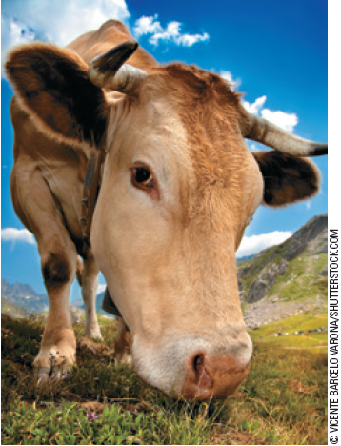
Why the cow is not extinct, Part 1
Animals with commercial value that are threatened with extinction
Buffalo
North America
Hunting in the 19th century
Elephants
African countries
Hunting today
“Will the market protect me?”

Slide 24
Why the cow is not extinct, Part 2
The cow
Commercial value
Species continues to thrive
Cows are a private good
Ranches are privately owned
Rancher: great effort to maintain the cattle population on his ranch
Reaps the benefit

Slide 25
Why the cow is not extinct, Part 3
Elephant - common resource
Poachers are numerous
Strong incentive to kill elephants
Government of Kenya, Tanzania, and Uganda
Illegal to kill elephants and sell ivory
Hard to enforce laws
Decreasing population of elephants

Slide 26
Why the cow is not extinct, Part 4
Government of Botswana, Malawi, Namibia, and Zimbabwe
Made elephants a private good
People can kill elephants on their own property
Landowners have an incentive to preserve the species
Elephant populations have started to rise

Slide 27
Importance of Property Rights, Part 1
Market fails to allocate resources efficiently
Because property rights are not well established
Some item of value does not have an owner with the legal authority to control it

Slide 28
Importance of Property Rights, Part 2
The government can potentially solve the problem
Help define property rights and thereby unleash market forces
Regulate private behavior
Use tax revenue to supply a good that the market fails to supply

